Slide 1
Movie Gross Project
Presentation done by Vincent Ogutu

Slide 2
Summary
The Project was motivated by the need of Microsoft to get into creating a new movie studio while they are a green horn in this. The consultant was charged with exploring the types of films that are currently in the box office with the findings being translated into actionable insights for Microsoft.
The consultant used Exploratory Data Analysis (EDA), employing Pandas and Matplotlib to arrive at the findings. It was discovered that foreign markets are performing way better than the domestic markets in the time period considered. This should be of interest to Microsoft on where it would want to focus its energy. It was further discovered that BV Studio was the best both in the domestic and foreign markets. It will be of interest for Microsoft to study their business strategies.

Slide 3
Outline
Business Problem: Microsoft wants to get into the business of creating a new movie studio while they do not know anything about creating movies. The motivation emanates from the big companies creating original video content.
The consultant is charged with exploring the types of films that are currently the best at the box office. The findings must be translated into actionable insights that the head of Microsoft’s new movie studio can use in deciding the type of films to create.
Data: Exploratory Data Analysis (EDA) will be used to generate insights for Microsoft.
Methods: Pandas and Matplotlib will be used for analysis.
Results: The results will be shared in a non-technical term to enable comprehension of the findings.
Conclusions: The conclusions will be given in such a manner that will be useful for Microsoft in making the decision regarding the Project.

Slide 4
Business Problem
Microsoft wants to get into the business of creating a new movie studio while they do not know anything about creating movies. The motivation emanates from the big companies creating original video content.
The consultant is charged with exploring the types of films that are currently the best at the box office. The findings must be translated into actionable insights that the head of Microsoft’s new movie studio can use in deciding the type of films to create.

Slide 5
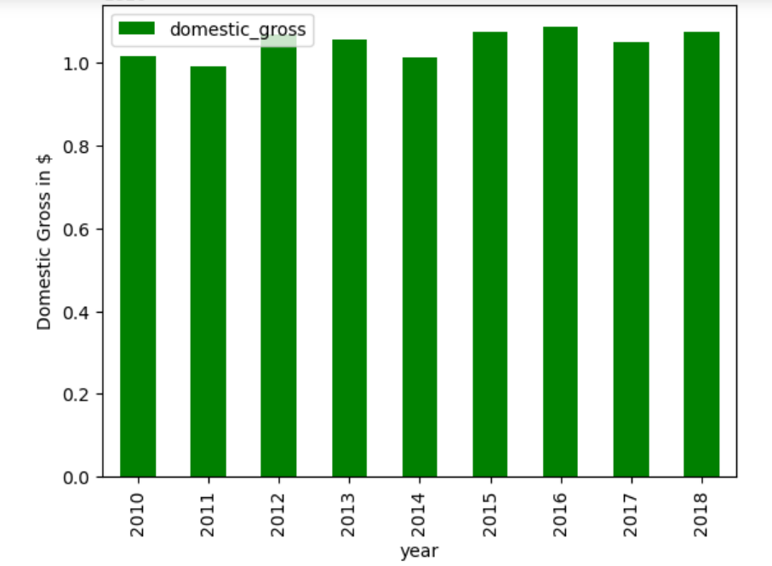
Data

Slide 6
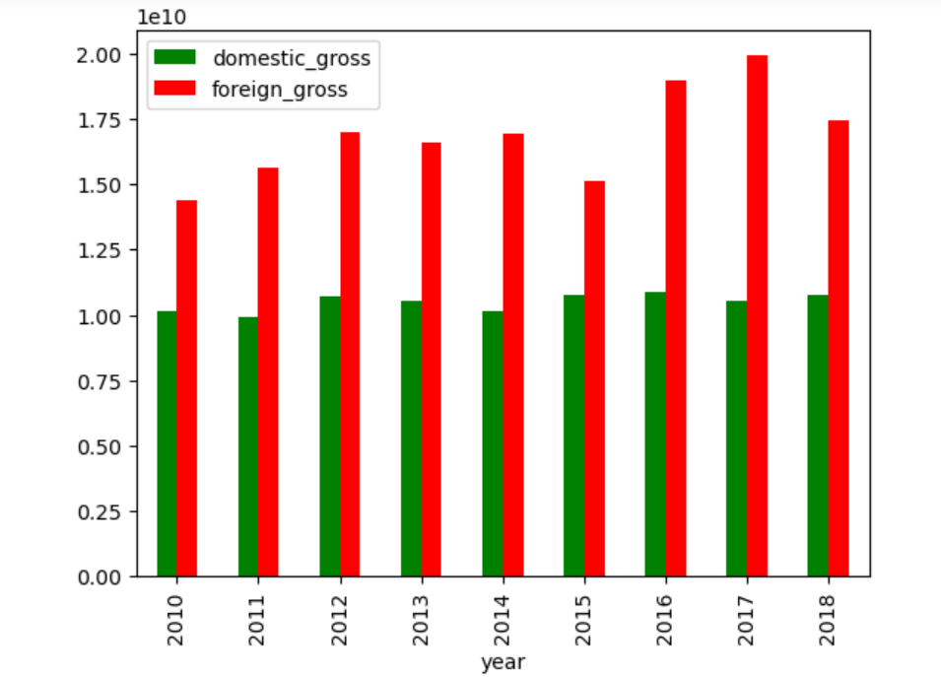
Cont’d

Slide 7
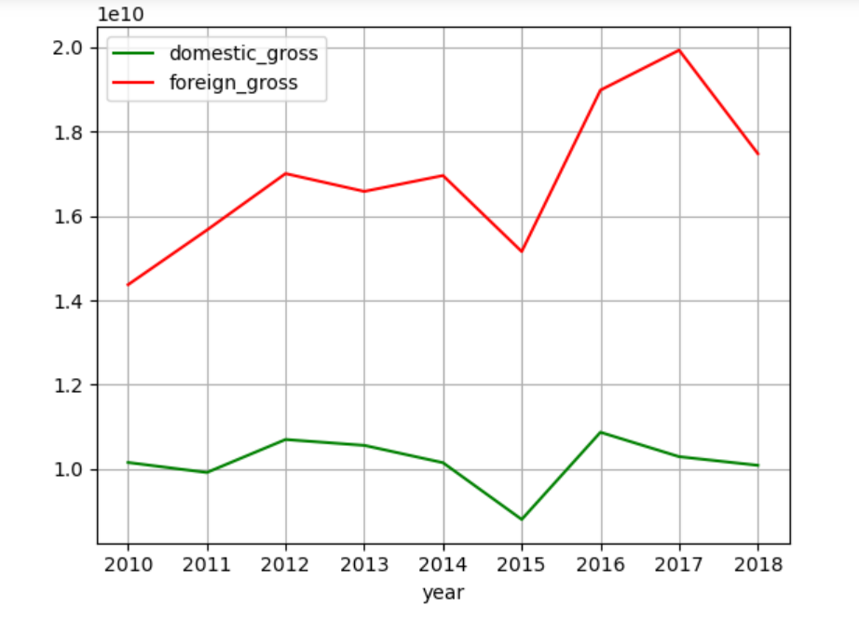
Cont’d

Slide 8
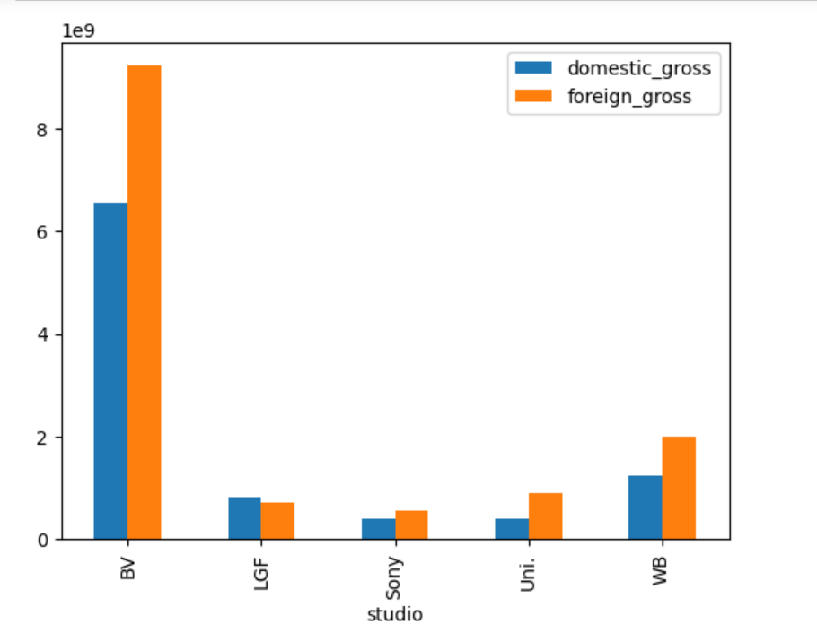
Cont’d

Slide 9
Methods
In order to carry out the analysis the movie gross file was retrieved from the repository through the link that was provided. This was then followed by importing and analysing using Pandas and MatPlotLib in the Jupyeter Notebook. The Data was cleaned and null values dropped. It was discovered that the Year 2015 had the highest number of null values for both domestic gross and foreign gross.

Slide 10
Results
Through analysis, it was discovered that the foreign gross is performing better domestic gross within the time period considered. It was also noted that BV studio was performing the best in both the domestic gross and foreign gross and followed by WB. This is a pointer to Microsoft to check and study what BV is doing that other studios are not doing in order for her to perform even better than BV in this front.

Slide 11
Conclusions
While entering the market, Microsoft would want to study the business strategies used by BV Studio in order to position and take the market. More so, Microsoft would want to concentrate her efforts in the foreign markets as opposed to the domestic market as the data demonstrates that the foreign market revenue has always been in an all time high in the period under consideration.
One limitation of the analysis is the missing values in the year 2015 and this should be taken into consideration if at all significant.

Slide 12
Thank You!
Email:vincent.ogutu@student.moringaschool.com GitHub: Ogutu33-hub
LinkedIn: Vincent Ogutu

